Slide 1

Implicit/Explicit scheme for 2D advection diffusion problem
Mech587 Project #2
Xiaoyu Mao
Nov. 7, 2022
Notes:
Good morning, Prof Carl, James and Jasmin. Today I will give you a update on my proposal titled a unified Eulerian Variational Framework for multiphase FSI. The focus of this talk will be how to unify the description of the solid and fluid in a fully Eulerian frame of reference, and how to handle the interface in a fixed mesh.

Slide 2
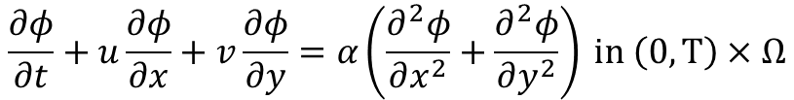



2D advection-diffusion: Definition
Problem description:
The current value of the function is know.
The function follows certain condition on the boundary.
The evolution of the function is governed by the governing equation.
We want to predict the solution in the future
Governing equation
$$\frac{∂φ}{∂t}+u\frac{∂φ}{∂x}+v\frac{∂φ}{∂y}=α\left(\frac{∂^{2}φ}{∂x^{2}}+\frac{∂^{2}φ}{∂y^{2}}\right) in \left(0,T\right)×Ω$$
room
Evolution
advection
Wave-like solution
Diffusion
Damping/smear
heat flux
aircon
Initial condition (IC)
$$φ\left(x,y,0\right)=f(x,y)$$
diffusion
Boundary condition (BC)
Dirichlet (function value is given):
Neumann (flux is given, e.g., heat flux):
advection
$$φ=φ_{0}$$
Wall temp
$$\frac{∂φ}{∂n}=g$$
$$(n denote the normal direction to the boundary)$$
Notes:
First, let me introduce the context of my research topic. The current research topic is motivated by the intelligent and green marine vessel proposal. We focus on the development of tools which make the marine vessels intelligent and environmentally friendly. Combining the high-fidelity model-based simulation and data driven techniques, we want to make the design and operation of the next generation marine vessels more interactive, automized, efficient and green. My focus is to reduce the noise of the ship and its harm to the marine mammals. This requires high fidelity simulation of multiphase fluid structure interaction.

Slide 3
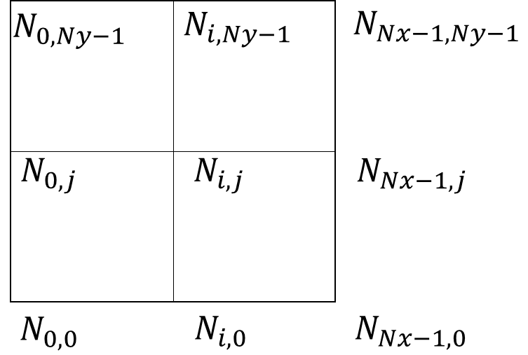
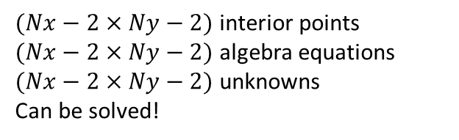


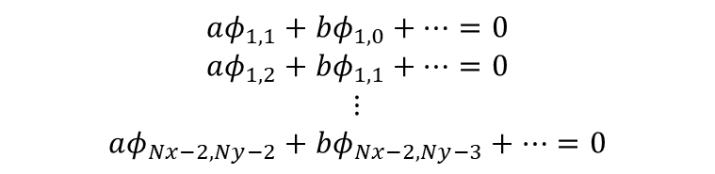

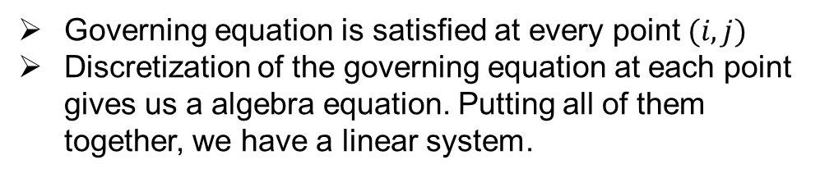




Discretization
Governing equation is satisfied at every point $(i,j)$
Discretization of the governing equation at each point gives us a algebra equation. Putting all of them together, we have a linear system.
$${\left(\frac{∂φ}{∂t}+u\frac{∂φ}{∂x}+v\frac{∂φ}{∂y}=α\left(\frac{∂^{2}φ}{∂x^{2}}+\frac{∂^{2}φ}{∂y^{2}}\right)\right)}_{i,j}⇒aφ_{i,j}+bφ_{i,j−1}+⋯=0$$
All together
$$⇓$$
$$aφ_{1,1}+bφ_{1,0}+⋯=0$$
$$aφ_{1,2}+bφ_{1,1}+⋯=0$$
$$⋮$$
$$aφ_{Nx−2,Ny−2}+bφ_{Nx−2,Ny−3}+⋯=0$$
$(Nx−2×Ny−2)$ interior points
$(Nx−2×Ny−2)$ algebra equations
$(Nx−2×Ny−2)$ unknowns
Can be solved!
$$⟹Aφ=b$$
$b$ come from BC or source term
We can treat the terms one by one
Spatial discretization
How the spatial derivatives are evaluated with given mesh?
Temporal discretization
At which moment am I approximating the evolution?
$${\left(α\left(\frac{∂^{2}}{∂x^{2}}+\frac{∂^{2}}{∂y^{2}}\right)φ\right)}_{i,j}$$
$${\left(\left(u\frac{∂}{∂x}+v\frac{∂}{∂y}\right)φ\right)}_{i,j}$$
Diffusion:
Advection:
Explicit Euler:
$$\frac{∂φ}{∂t}=f(φ^{n})$$
Implicit Euler:
$$\frac{∂φ}{∂t}=f(φ^{n+1})$$
Notes:
First, let me introduce the context of my research topic. The current research topic is motivated by the intelligent and green marine vessel proposal. We focus on the development of tools which make the marine vessels intelligent and environmentally friendly. Combining the high-fidelity model-based simulation and data driven techniques, we want to make the design and operation of the next generation marine vessels more interactive, automized, efficient and green. My focus is to reduce the noise of the ship and its harm to the marine mammals. This requires high fidelity simulation of multiphase fluid structure interaction.

Slide 4

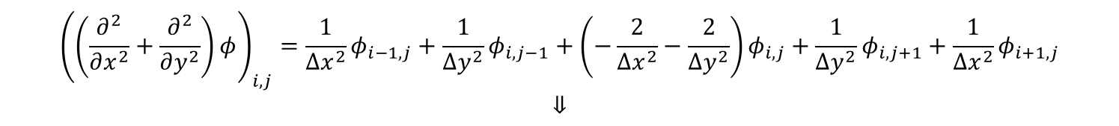
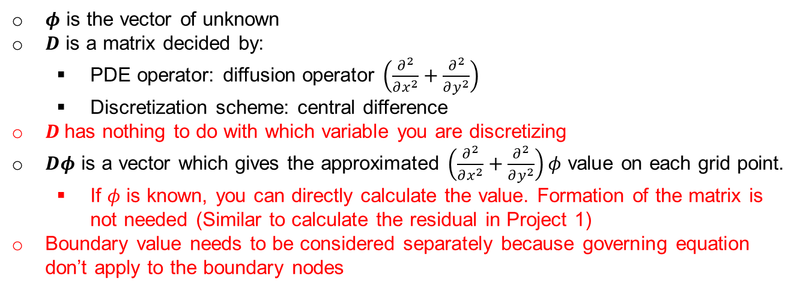

Spatial discretization
Example: diffusion with central difference
$${\left(\left(\frac{∂^{2}}{∂x^{2}}+\frac{∂^{2}}{∂y^{2}}\right)φ\right)}_{i,j}=\frac{1}{Δx^{2}}φ_{i−1,j}+\frac{1}{Δy^{2}}φ_{i,j−1}+\left(−\frac{2}{Δx^{2}}−\frac{2}{Δy^{2}}\right)φ_{i,j}+\frac{1}{Δy^{2}}φ_{i,j+1}+\frac{1}{Δx^{2}}φ_{i+1,j}$$
$$⇓$$
All together
$φ$ is the vector of unknown
$D$ is a matrix decided by:
PDE operator: diffusion operator $\left(\frac{∂^{2}}{∂x^{2}}+\frac{∂^{2}}{∂y^{2}}\right)$
Discretization scheme: central difference
$D$has nothing to do with which variable you are discretizing
$Dφ$ is a vector which gives the approximated $\left(\frac{∂^{2}}{∂x^{2}}+\frac{∂^{2}}{∂y^{2}}\right)φ$ value on each grid point.
If $φ$ is known, you can directly calculate the value. Formation of the matrix is not needed (Similar to calculate the residual in Project 1)
Boundary value needs to be considered separately because governing equation don’t apply to the boundary nodes
$$Dφ$$
$$\frac{∂φ}{∂t}=−u\frac{∂φ}{∂x}−v\frac{∂φ}{∂y}+α\left(\frac{∂^{2}φ}{∂x^{2}}+\frac{∂^{2}φ}{∂y^{2}}\right)$$
PDE:
$$⇓$$
Spatial discretization:
$$\frac{∂φ}{∂t}=−Aφ+Dφ$$
Semi discrete form:
Notes:
First, let me introduce the context of my research topic. The current research topic is motivated by the intelligent and green marine vessel proposal. We focus on the development of tools which make the marine vessels intelligent and environmentally friendly. Combining the high-fidelity model-based simulation and data driven techniques, we want to make the design and operation of the next generation marine vessels more interactive, automized, efficient and green. My focus is to reduce the noise of the ship and its harm to the marine mammals. This requires high fidelity simulation of multiphase fluid structure interaction.

Slide 5

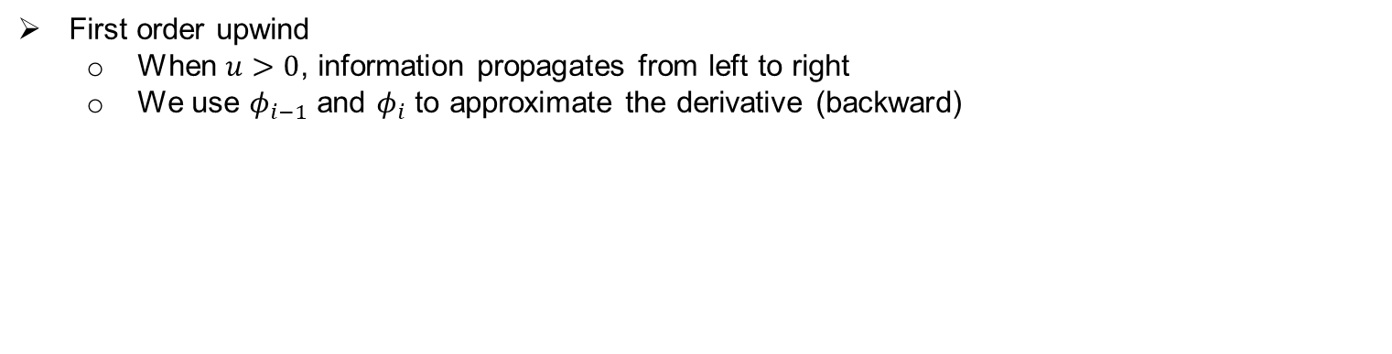



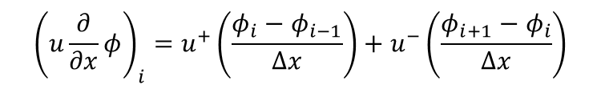
Upwind discretization for advection term
Advection term:
$${\left(u\frac{∂}{∂x}φ\right)}_{i}$$
First order upwind
When $u>0$, information propagates from left to right
We use $φ_{i−1}$ and $φ_{i}$ to approximate the derivative (backward)
$${\left(\frac{∂}{∂x}φ\right)}_{i}=\frac{φ_{i}−φ_{i−1}}{Δx}$$
When $u<0$, information propagates from right to left
We use $φ_{i+1}$ and $φ_{i}$ to approximate the derivative (forward)
$${\left(\frac{∂}{∂x}φ\right)}_{i}=\frac{φ_{i+1}−φ_{i}}{Δx}$$
Define $u^{+}=0.5(u+\left|u\right|)$, we have $u^{+}=u$ for $u>0$ and $u^{+}=0$ for $u≤0$
Define $u^{−}=0.5(u−\left|u\right|)$, we have $u^{−}=u$ for $u<0$ and $u^{−}=0$ for $u≥0$
$${\left(u\frac{∂}{∂x}φ\right)}_{i}=u^{+}\left(\frac{φ_{i}−φ_{i−1}}{Δx}\right)+u^{−}\left(\frac{φ_{i+1}−φ_{i}}{Δx}\right)$$
Second order upwind
$${\left(u\frac{∂}{∂x}φ\right)}_{i}=u^{+}\left(\frac{{3φ}_{i}−4φ_{i−1}+φ_{i−2}}{2Δx}\right)+u^{−}\left(\frac{{−3φ_{i}+4φ}_{i+1}−φ_{i+2}}{2Δx}\right)$$
${\left(u\frac{∂}{∂x}φ\right)}_{i}=Aφ$. Upwind is not symmetry. $A^{−1}$ may be hard to calculate
Notes:
First, let me introduce the context of my research topic. The current research topic is motivated by the intelligent and green marine vessel proposal. We focus on the development of tools which make the marine vessels intelligent and environmentally friendly. Combining the high-fidelity model-based simulation and data driven techniques, we want to make the design and operation of the next generation marine vessels more interactive, automized, efficient and green. My focus is to reduce the noise of the ship and its harm to the marine mammals. This requires high fidelity simulation of multiphase fluid structure interaction.

Slide 6




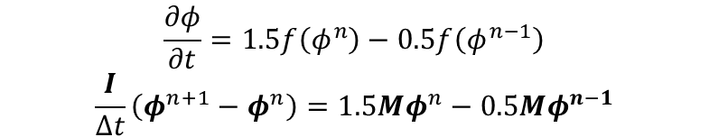
Temporal discretization
$$\frac{∂φ}{∂t}=f(φ)$$
Consider problem
Explicit schemes evaluated the derivative at previous time steps:
Forward Euler:
$$\frac{∂φ}{∂t}=f\left(φ^{n}\right)⇒\frac{I}{Δt}\left(φ^{n+1}−φ^{n}\right)=Mφ^{n}$$
$$φ^{n+1}=\left(I+MΔt\right)φ^{n}$$
Adams-Bashforth:
$$\frac{∂φ}{∂t}=1.5f\left(φ^{n}\right)−0.5f\left(φ^{n−1}\right)$$
$$\frac{I}{Δt}\left(φ^{n+1}−φ^{n}\right)=1.5Mφ^{n}−0.5Mφ^{n−1}$$
Two-step method
You can start with FE
$$φ^{n+1}=φ^{n}+1.5MΔtφ^{n}−0.5MΔtφ^{n−1}$$
No inverse of matrix
Implicit schemes evaluated the derivative at previous time steps:
Backward Euler:
$$\frac{∂φ}{∂t}=f\left(φ^{n+1}\right)⇒\frac{I}{Δt}\left(φ^{n+1}−φ^{n}\right)=Mφ^{n+1}$$
$$φ^{n+1}={\left(I−MΔt\right)}^{−1}φ^{n}$$
Need to calculate inverse of matrix
For $M$ which is easy to be inversed, we want to used implicit scheme.
For $M$ which is hard to be inversed, we want to used explicit scheme.
Notes:
First, let me introduce the context of my research topic. The current research topic is motivated by the intelligent and green marine vessel proposal. We focus on the development of tools which make the marine vessels intelligent and environmentally friendly. Combining the high-fidelity model-based simulation and data driven techniques, we want to make the design and operation of the next generation marine vessels more interactive, automized, efficient and green. My focus is to reduce the noise of the ship and its harm to the marine mammals. This requires high fidelity simulation of multiphase fluid structure interaction.

Slide 7


Implicit/Explicit scheme
Consider the problem:
$$\frac{∂φ}{∂t}=−\left(u\frac{∂}{∂x}+v\frac{∂}{∂y}\right)φ+α\left(\frac{∂^{2}}{∂x^{2}}+\frac{∂^{2}}{∂y^{2}}\right)φ$$
The semi-discrete form:
$$\frac{∂φ}{∂t}=−Aφ+Dφ$$
With central difference, $D$ is easy to be inverted
With upwind, $A$ is hard to be inverted
Explicit for $Aφ$ (AB2), Implicit for $Dφ$ (Trapezoidal)
$\frac{I}{Δt}\left(φ^{n+1}−φ^{n}\right)=−(1.5Aφ^{n}−0.5Aφ^{n−1})+D(0.5φ^{n}+0.5φ^{n+1}$)
Explicit scheme, forward calculation. Don’t need to form matrix
You need to use Newton-Raphson method to calculate $δφ$
Use as much existing code as you can!
Notes:
First, let me introduce the context of my research topic. The current research topic is motivated by the intelligent and green marine vessel proposal. We focus on the development of tools which make the marine vessels intelligent and environmentally friendly. Combining the high-fidelity model-based simulation and data driven techniques, we want to make the design and operation of the next generation marine vessels more interactive, automized, efficient and green. My focus is to reduce the noise of the ship and its harm to the marine mammals. This requires high fidelity simulation of multiphase fluid structure interaction.

Slide 8
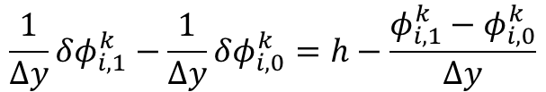

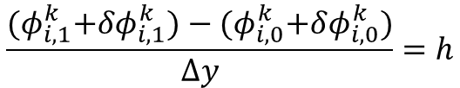
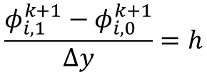


Neumann boundary condition
Suppose we have Neumann boundary condition on the bottom boundary:
$$\frac{∂φ}{∂n}=\frac{∂φ}{∂y}\left(y=0\right)=h$$
With first order one-side difference at $N_{i,0}$
$$\frac{φ_{i,1}−φ_{i,0}}{Δy}=h$$
The boundary condition needs to be satisfied after updating:
$$\frac{φ_{i,1}^{k+1}−φ_{i,0}^{k+1}}{Δy}=h$$
$$\frac{{(φ}_{i,1}^{k}+δφ_{i,1}^{k})−{(φ}_{i,0}^{k}+δφ_{i,0}^{k})}{Δy}=h$$
Finally we have the discrete form of the Neumann boundary condition:
$$\frac{1}{Δy}δφ_{i,1}^{k}−\frac{1}{Δy}δφ_{i,0}^{k}=h−\frac{φ_{i,1}^{k}−φ_{i,0}^{k}}{Δy}$$

